Slide 1

R.V.R & J.C College of Engineering Chowdavaram,Guntur,A.P.
Team number-22
Classification of Lung and Colon Cancer Histopathological
Images Using Global Context Attention Based Convolutional
Neural Network
Guide Name : Sri. N.Chandra Sekhar
TEAM MEMBERS:-
Y21CS182 V AKSHAY SAI
Y21CS184 V SAI PHANINDRA
Y21CS170 T VENKATA NARAYANA

Slide 2
AGENDA:-
Team number-22
ABSTRACT
EXISTING SYSTEM & LIMITATIONS
PROPOSED SOLUTIONS
ALGORITHUM USED
DETAILS OF DATASETS
IMPLEMENTATION DETAILS
RESULTS & PERFORMANCE ANALYSIS
CONCLUSION

Slide 3
Abstract:- Team number-22
This project focuses on lung and colon cancer classification using histopathological images.
A Global Context Attention-Based CNN (GC-CNN) is proposed to improve classification accuracy.
The model integrates Global Context Attention (GCA) and CBAM to enhance feature extraction.
GAN-based augmentation is used to increase dataset size and improve robustness.
Achieves 99.76% image-level accuracy and 96.5% patient-level accuracy, outperforming existing models.
Reduces computational cost, making it suitable for mobile deployment.
Uses Grad-CAM visualization to interpret model predictions.

Slide 4
Team Number:22
Existing System & Limitations:-
Traditional CNN and Transfer Learning approaches.
These models are trained on general image datasets (like ImageNet), which contain natural images (animals, objects) rather than medical histopathology images.
As a result, they fail to capture the cancer features, leading to misclassification of similar cancer subtypes.
Limited datasets lead to overfitting.
Small dataset sizes cause poor generalization on new data.
Deep learning models require large datasets to generalize well; small datasets cause overfitting, where the model performs well on training data but poorly on new data.
Lack of diverse cancer histology images leads to biased predictions.

Slide 5
3. High computational cost.
Deep models require high memory and processing power due to a large number of parameters and operations.
High hardware requirements (GPUs, TPUs) make deployment on low-power devices (e.g., mobile, embedded systems) challenging.
Optimizations like separable convolutions and attention mechanisms can help reduce computation.
4. Poor feature extraction, affecting classification accuracy.
Difficulty in differentiating similar cancer subtypes (e.g., lung adenocarcinoma vs. squamous cell carcinoma).
Standard CNNs focus on low-level features (edges, textures) but fail to capture fine-grained medical details.
5. No patient-level accuracy measurement.
Current models lack a framework for aggregating multiple image results into a patient-level diagnosis.
Most models focus only on individual image classification.
No comprehensive evaluation at the patient level for real-world applications.

Slide 6
Team Number:22
Proposed Solutions:-
Introduced Global Context Attention Module.
Used GAN-based data augmentation.
Implemented separable convolutions for efficiency.
Used Grad-CAM for interpretability.
Measured both image-level and patient-level accuracy.

Slide 7
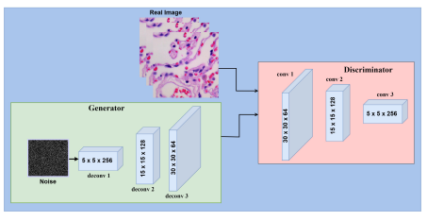
Fig:-Proposed generative adversarial network architecture consisting of generator and discriminator.

Slide 8
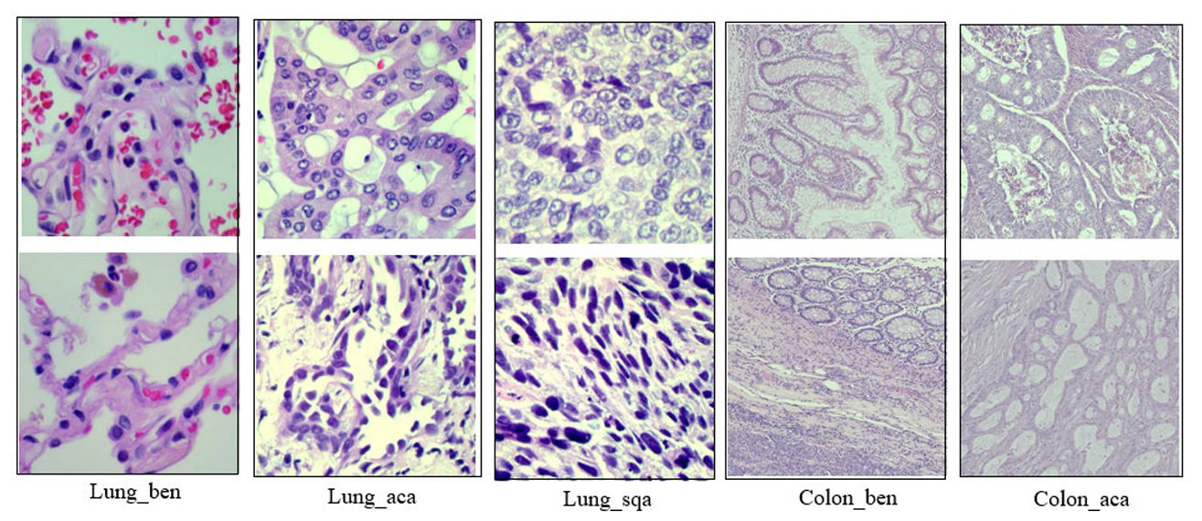
Fig:- GAN generated image samples.

Slide 9
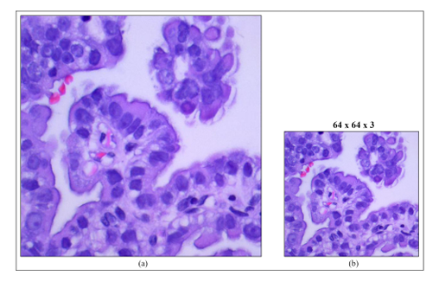
Fig:-Example of resizing. (a) : Original image. (b): Resized image.

Slide 10
METHODOLOGY-MODULE PROPOSED:-
Team number-22
Global Context Attention-Based Convolutional Neural Network (GCACNN):-
This methodology combines a CNN architecture with a specialized Global Context (GC) Attention Module to enhance feature extraction for improved classification of lung and colon cancer images.

Slide 11
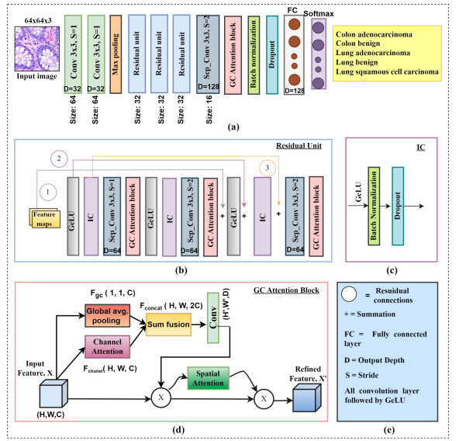
ARCHITECTURE:-
Fig:- The overall framework of the proposed method. (a) CNN baseline architecture. (b) Reformulating residual unit. (c) IC layer. (d) GC attention block. (e) Key showing important components.

Slide 12
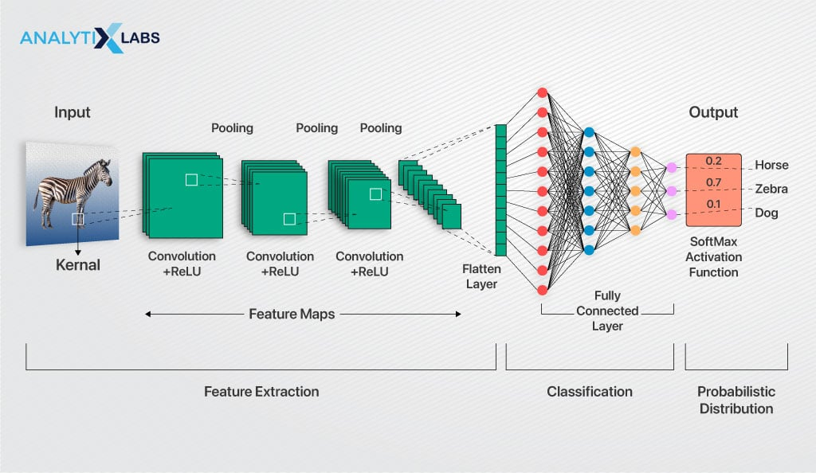

Slide 13
DETAILS OF PROPOSED TECHNIQUES:-
1. CNN Architecture for Feature Extraction:
The CNN backbone extracts both low-level features (edges, textures) and high-level features (patterns, objects) from histopathological images. It consists of multiple convolutional and pooling layers that hierarchically capture and reduce spatial dimensions, aiding in the differentiation of cancerous and non-cancerous tissues.
2. Integration of the GC Attention Module:
The GC Attention Module enhances the CNN by focusing on the most informative regions through Channel Attention (prioritizing relevant features like color and texture) and Spatial Attention (focusing on important areas, such as tumor regions). This improves the model’s ability to detect cancerous tissues while reducing noise from irrelevant regions.
3. Global Context (GC) for Semantic Information:
The GC attention module captures global context by analyzing the entire image or significant portions, enabling the model to understand broader spatial relationships. This helps differentiate complex patterns, such as benign vs. malignant tumors, by considering contextual information beyond local pixel similarities.
4. Final Classification:
The enhanced features from the CNN and GC Attention Module are processed through fully connected layers for final classification. The output layer uses a softmax or sigmoid function to predict whether the image is cancerous or non-cancerous, or to classify the type of cancer in multi-class problems.

Slide 14
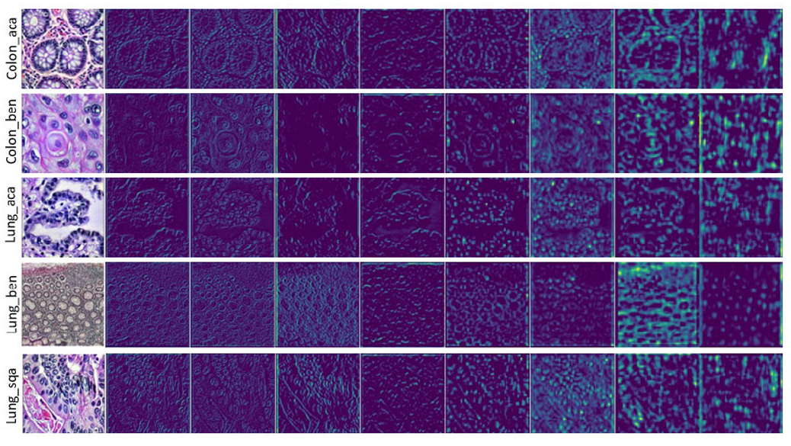
Fig:- Each row showing low-to-high level convolutional feature maps using the proposed model.

Slide 15
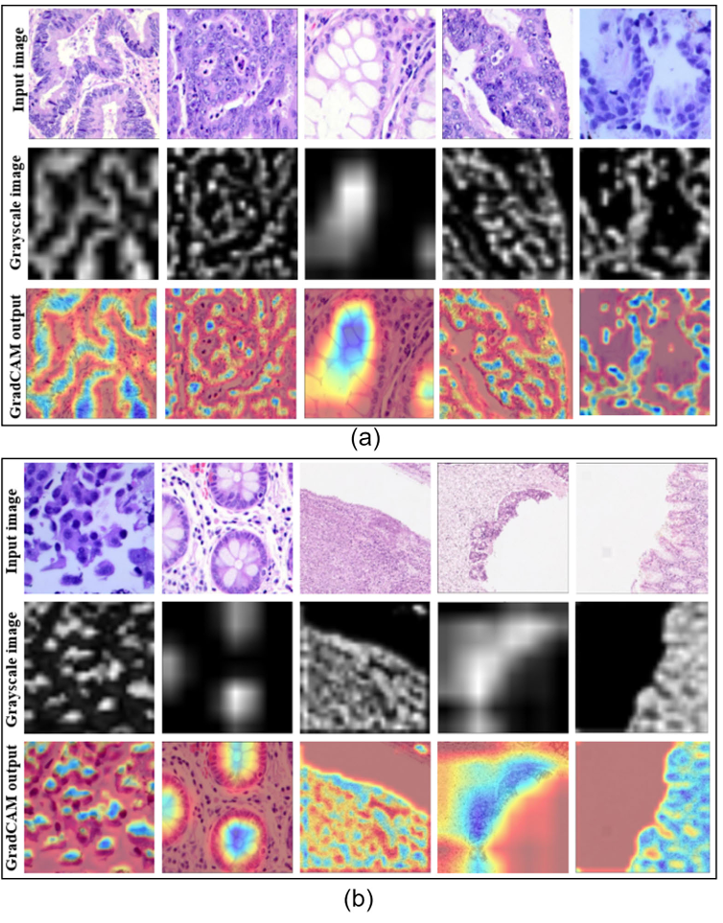
Fig:- Examples of GradCAM visualization outcome. (a) : Lung cancer samples. (b): Colon cancer samples.

Slide 16
ALGORITHUM:- Team Number 22
1.Import Libraries and Modules:
Import necessary libraries like TensorFlow/Keras for model building and NumPy, OpenCV for image processing.
Load and Preprocess Dataset:
Load histopathological images.
Resize and normalize images.
Apply data augmentation to increase variability and prevent overfitting.
Define CNN Model Architecture:
Build the CNN with layers such as Conv2D, MaxPooling2D, and Dense.
Add Dropout and Batch Normalization layers for regularization.
Compile the Model:
Select an optimizer like Adam.
Use categorical cross-entropy loss for multi-class classification.
Set accuracy as the evaluation metric.
Train the Model:
Fit the model on the training dataset with validation data for monitoring performance.
Evaluate the Model:
Test the model on the unseen test dataset.
Calculate accuracy and other evaluation metrics.
Save and Visualize Results:
Save the trained model for future inference.
Visualize results using confusion matrix and other relevant metrics.

Slide 17
DETAILS OF DATASETS:- Team Number:22
Dataset Name | Total Size | Content | Training Set | Testing Set
LC25000 | 25,000 images | Lung and colon tissue images, categorized (adenocarcinoma, squamous cell carcinoma, benign) | 20,000 images (80%) | 5,000 images (20%)
GLaS | 165 images | Histological sections stained with Hematoxylin & Eosin (H&E) | 132 images (80%) | 33 images (20%)
CRAG | 193 samples | 148 adenocarcinoma and 45 benign colon tissue samples | 135 samples (70%) | 58 samples (30%)
Kather Multiclass | 100,000 patches | H&E stained tissue patches representing multiple tissue classes | 80,000 patches (80%) | 20,000 patches (20%)

Slide 18
Team Number:-22
Implementation Details:-
Programming Language: Python 3.7
Libraries & Frameworks:
TensorFlow & Keras – Deep learning model development
FastAI – Optimized training and hyperparameter tuning
Scikit-Learn & OpenCV – Data processing & performance evaluation
Matplotlib & Seaborn – Visualization
Hardware Used:
Google Colab Pro (TPU-enabled training)
Asus TUF Gaming A15 (Ryzen 5 4600H, RTX 3050, 8GB RAM)
Evaluation Metrics:
Accuracy, F1-Score, MCC, FLOPs, Inference Time

Slide 19
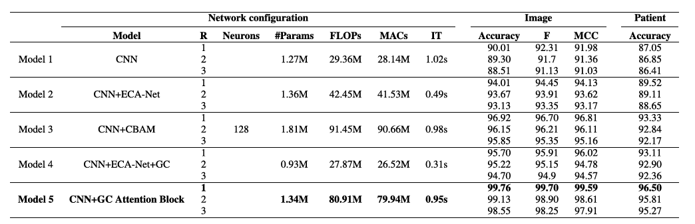
EXPERIMENTAL SETTINGS:
Fig. Performance evaluation for different Network configurations of scratch CNN where R, IT, F, MCC for the residual unit, inference time, F1-score,Matthews correlation coefficient, respectively

Slide 20
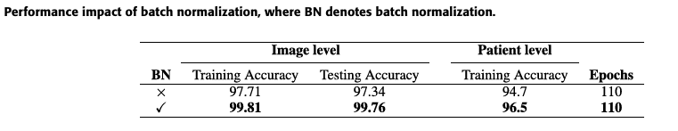
Team number-22

Slide 21
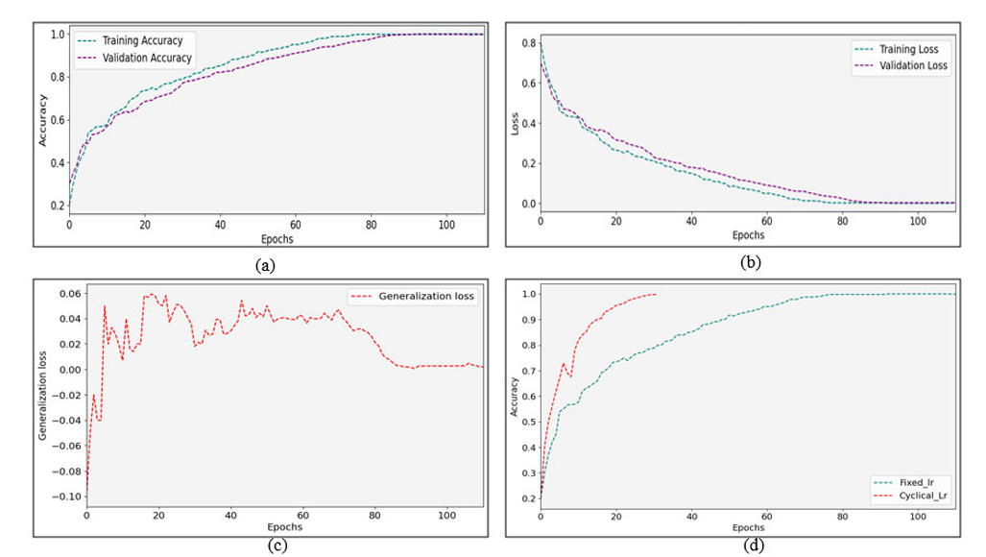
ANALYSIS OF RESULTS:-
Fig: Combined dataset outcomes. (a) : Accuracy comparison curve (fixed lr).(b): Loss comparison curve (fixed lr). (c): Generalization loss curve (fixed lr), which is the gap between validation and training loss. (d): Observation of super convergence (validation accuracy).

Slide 22
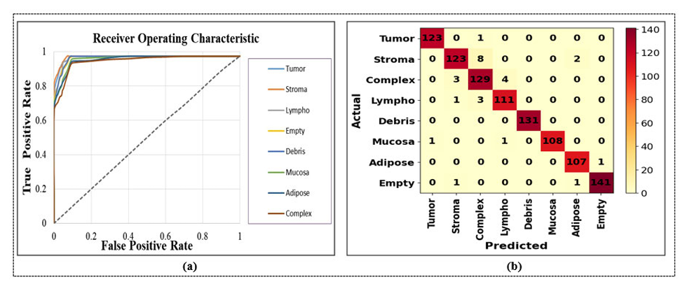

Slide 23

Team number-22

